Slide 1

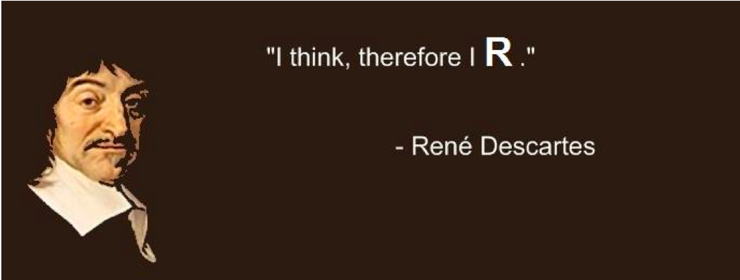
introduction
Huitian Diao (Yolanda)
”You think, therefore you R.”
- René Descartes
References:
Quick-R by DataCamp
R for Beginners by Emmanuel Paradis

Slide 2

Using sticky notes for feedback
“I’ve got a good handle on things…”
“I think I understand but I’m still working through things…”
“I’m not understanding and I’m a little lost right now...”

Slide 3
Get course material
Github
Applied-Bioinformatics
Github
HW
git pull
git push
copy
My local:
Applied-Bioinformatics
My local:
Applied-Bioinformatics

Slide 4

Type codes, not copy & paste
I just copy-pasted those codes …
What did
you say?

Slide 5
Practice 2.3 !
Commends:
read.csv()
order()
df[]
head()
dim()
X <- function() {}
cbind()
subset()
factor()
summary()
write.table()
Objectives:
Import NAV-D14_DEseq2.csv to a dataframe, sort according to padj
Check the first 7 rows and last 8 rows of dataframe. Check the dimensions of the dataframe.
Create a self defined function that evaluate p-value, use lappy to apply function to all the pvalues, and use summarize p-value types.
# p-value types
# p > 0.05: n.s.
# 0.05 >= p > 0.01: *
# 0.01 >= p > 0.001: **
# 0.001 >= p > 0.0001: ***
# 0.0001 >= p: ****
Add list of p-value type to dataframe, subset dataframe to exclude p-value that is not significant, and write the dataframe into a csv file.

Slide 6
Minute card questions
1. R: create tables / lists
Vector | x <- c("a", "b", "c") | Create a vector
 | x <- c(1:10) | Create a numeric vector with number 1 to 10
 | x <- seq(0,10, by=2) | Create a numeric vector: 0 2 4 6 8 10
 | x <- vector(mode="character" , length=10) | Create an empty character vector with 10 elements
 | x <- character(10) | Create an empty character vector with 10 elements
 | x <- rep("Foo", 10) | Create an vector with “Foo” repeating 10 times
Matrix | matrix(, nrow=5, ncol=10) | Create a empty matrix with 5 rows and 10 columns
 | matrix(c(1:50), nrow=5, ncol=10) | Create a matrix with 5 rows and 10 columns with 1-50
Array | x <- array(c(1:27), dim=c(3,3,3)) | Create an array with 1-27 with 3 rows, 3 columns and 3 matrices
Data frame | x <- data.frame(vector.1, vector.2, vector.3) | Create a dataframe with vector
 | x <- data.frame(matrix(ncol=5, nrow=10)) | Create a datafrmae from an empty matrix
 | x <- as.data.frame(matrix.1) | Create a dataframe by converting matrix
 | x <- read.csv(“123.csv”) | Create a dataframe from reading a csv file
List | x <- list(my.name="Foo", my.num=2, "Foo" ) | Create a list with different types of things
* Refer to R-1.pptx – Data types for the characteristics of those data types

Slide 7
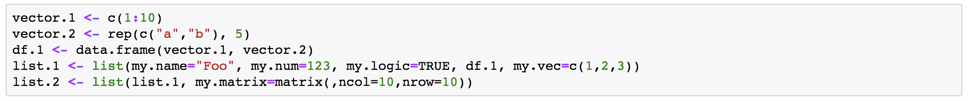
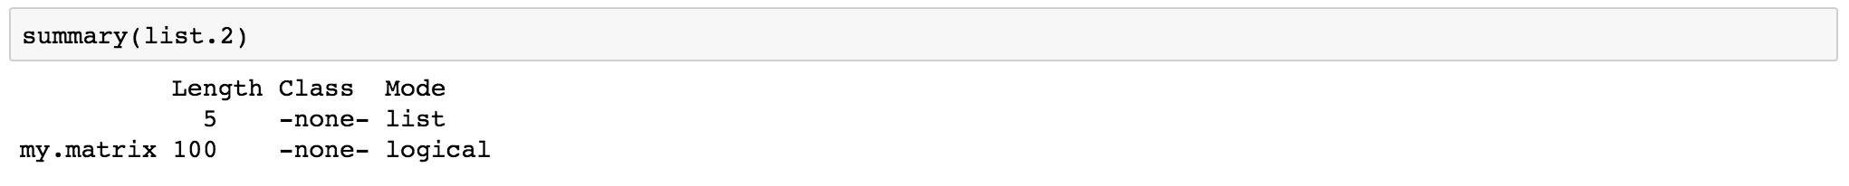
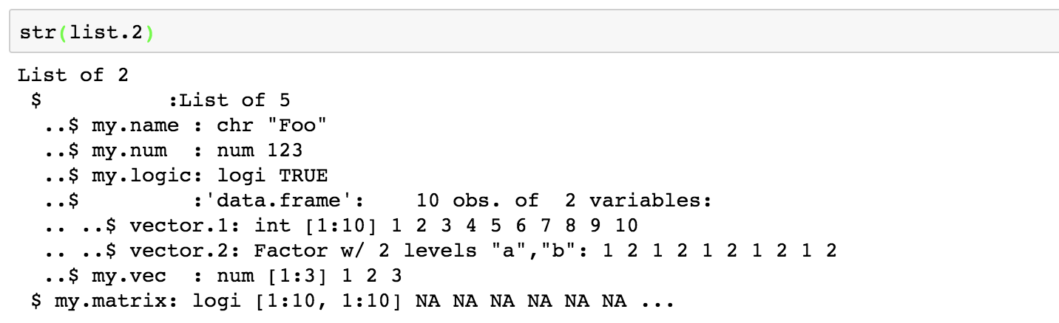
Minute card questions
2. What are “structures” in R2?
* str() is suitable to compactly display the abbreviated contents of (possibly nested) lists.

Slide 8
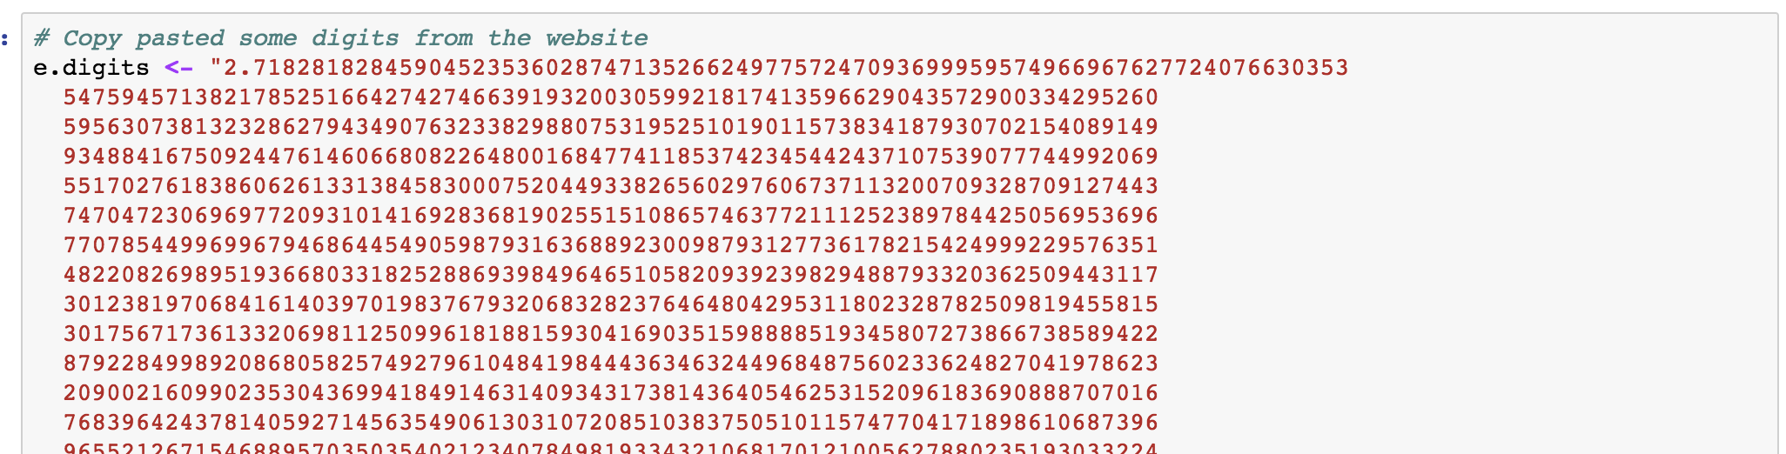
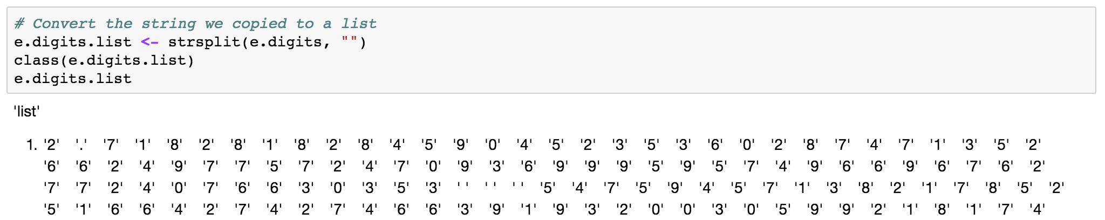
Minute card questions
3. Lot of trouble printing > 30 digits of pi for HW
Similar example question: make a vector with first 100 digits of e
( e digits: http://www-history.mcs.st-and.ac.uk/HistTopics/e_10000.html )

Slide 9
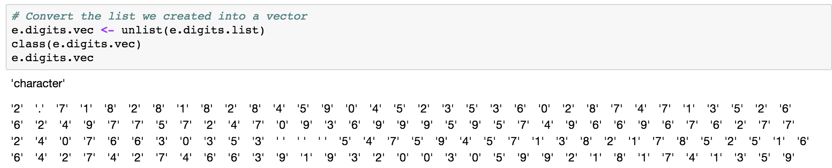
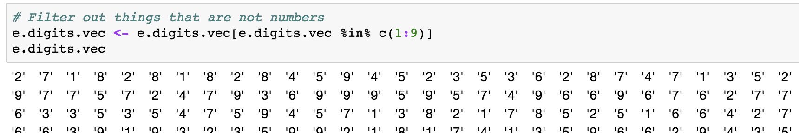
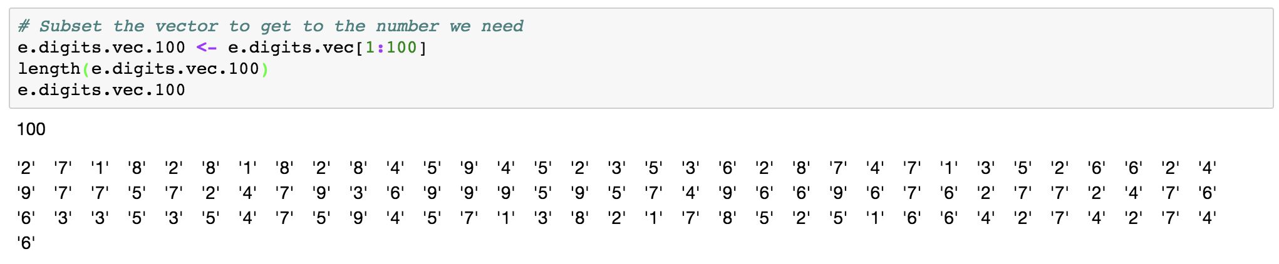
Minute card questions

Slide 10
Minute card questions
3. What is the difference between functions(if...else…, lapply..., function(x)) and loops (for i in..., while...., if...else) ?
Function: apply defined set of process for certain input
If… else… : execute process based on condition evaluation
Loops: repetitively execute a a set of statements
For: execute repeating process for a known list of elements
While: execute repeating process until meeting exit requirement
Lapply: basically same as for

Slide 11
Contents
R basic syntax
Object
Data types
Vectors
Matrices
Arrays
Data frames
Lists
Factors
Data type conversions
Basic function for objects
Basic data operations
Arithmetic operators
Logical operators
Common math built-in functions
Control structure
More data operations
Import data
Data frame operations
User defined functions
lapply
Flowchart

Slide 12
Flow chart: basic symbols
Flow line | Indicate the flow of logic by connecting symbols
Terminal (start / stop) | Represent start / end of flowchart
Input / Output | Used for input and output operation
Processing | Arithmetic operations and data-manipulations
Decision | Represent operation in which there are two alternatives, true and false

Slide 13
Use flow chart to represent process
Problem (if … else …):
For certain input number (integer), determine if it is a positive. If it is positive, print “Positive”. If not, end process, raise error.
Init
If (x>0) {
print(“Positive”)
}
else {
print(“Error, negative”)
}
Positive?
FALSE
Print “Error, negative”
Exit
TRUE
Print “Positive”

Slide 14
Use flow chart to represent process
Problem (if … else … else …):
For certain input number (integer), determine if it is a positive. If not, end process, raise error.
If it is positive, print “Positive”. And determine if it is an even number. Print “Even” or “Odd”.
Init
If (x>0) {
print(“Positive”)
if (x%%2==0) {
print(“Even”)
}
else{
print(“Odd”)
}
}
else {
print(“Error, negative”)
}
Positive?
FALSE
Print “Error, negative”
Exit
TRUE
Print “Positive”
Even ?
FALSE
Print “Odd”
TRUE
Print “Even”

Slide 15
Use flow chart to represent process
Problem (for …):
For all the numbers ranging from 1:10, print their square root.
Init
for(i in c(1:10)) {
i.sr <- sqrt(i)
print(i.sr)
}
i in c(1:10)
TRUE
i.sr <-sqrt(i)
print(i.sr)
FALSE
Exit

Slide 16
Use flow chart to represent process
Problem (while …):
Add arithmetic sequence 1, 2, 3, … till the sum exceed 1000, find out which number is the last in the sequence.
Init
num <- 1
sum <- 1
while(sum <= 1000) {
num <- num+1
sum <- sum + num
}
num <- 1
sum <- 1
sum <= 1000
TRUE
num <- num + 1
sum <- sum + num
FALSE
print(num)
Exit

Slide 17

Practice 2.4 !
Flow line
Terminal (start / stop)
Input / Output
Processing
Decision
Draw flow charts to represent the following process and translate into R codes:
For a certain input vector, determine if it is a numeric vector. If it is, then calculate the sum of the vector, print the sum. # is.numeric() Determine if the vector is numeric # sum() Calculate the sum of the vector
Define a function that generate random integer ranging from 1:10, until you get 5 or you reached 1000 times. Return how many times you generated the random number till you got 5. If you didn’t get 5 in 1000 times, return FALSE. # sample(1:10, 1) Generate random integer between 1 and 10
Calculate 20 fibonacci numbers with the use of a while loop and print them. # Fibonacci numbers: 1, 1, 2, 3, 5 …

Slide 18
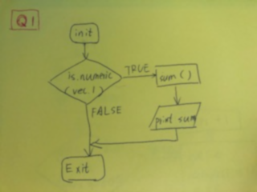
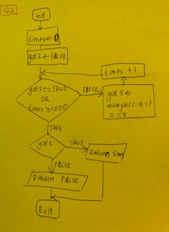
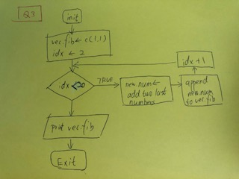
Practice 2.4 !

Slide 19
Flow chart: more symbols
Document
Database
Pre-defined process
Comments or annotation
On-page connector / reference
Off-page connector / reference
https://openi.nlm.nih.gov/detailedresult.php?img=PMC2553323_1752-0509-2-80-2&req=4
https://www.melbournebioinformatics.org.au/tutorials/tutorials/assembly/assembly-protocol/

Slide 20
Homework
1. Hello world everyday!
1.1 Make a vector containing days of the week, from Monday to Sunday.
1.2 Use a for loop to pring "Hello world XXXday!" for each day of the week.
2. The Pie
2.1 In the first 100 digits of pie, count how many numbers are even.
2.2 Convert the first 200 digits of pie into a 20x10 matrix
Please use the digits of Pie from this website: https://www.piday.org/million/
3. Prime numbers
Find first 500 prime numbers. What is the 500th prime number?
4. Fibonacci number
Define a function to return the Xth fibonacci number
Info about fibonacci numbers: https://en.wikipedia.org/wiki/Fibonacci_number (Use the sequence starts with 1,1, 2)

Slide 21
Homework
5. Read both NAV-D14_DEseq2.csv and NAV-MEM-DEseq2.csv into dataframes: df.nav.d14 and df.nav.mem .
5.1 Subset both dataframes to include only "gene.name", "baseMean", "log2FoldChange" and "padj"
5.2 Merge the two dataframes into a dataframe df.nav.d14.mem. (Change column names so that there are no repetative column names. The “baseMean” and “gene.name” in two spreadsheets are the same so delete the extra one.) 5.3 Sort the new dataframe on " baseMean".
5.4 Define a function to evaluate padj output:
padj > 0.05: nonsig - padj <= 0.05: sig
5.5 Use lapply to apply the function to padj of subsetted dataframes nav.mem and nav.d14 (not the combined df.nav.d14.mem) and create one column to add the evaluation result.

Slide 22
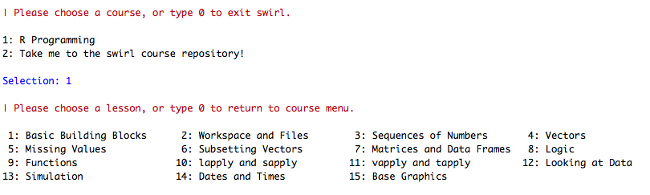
Assignment: Learn R by your self with Swirl
https://swirlstats.com/students.html
Review

